Slide 1
Penalized regression with Bayesian Shrinkage Priors and Application to Real-World Data
Enar 2023
Arinjita Bhattacharyya, Merck &Co., Inc.
Riten Mitra, University of Louisville
Notes:
Hello everyone, thank you so much for joining our tutorial session, Penalized regression with Bayesian Shrinkage priors and Application to Real-world data.
I am Arinjita and my advisor Dr. Riten Mitra will be teaching this tutorial together. I will go over the theory portions, and Dr. Riten Mitra will be joining to describe the simulation results and the application to real-world data portions. At any point, if you have any questions, please feel free to ask questions. Other than that we will have some time at the end of each session to answer your questions. So without further adieu let us dive into shrinkage priors and its applications.

Slide 2
Content
Penalized Regression
Bayesian Shrinkage Priors
Categorical Response Models
Results
Simulations
Discussion
Count Response Models
Data applications
Notes:
This is the roadmap for our talk. We will go over penalized regression, then Bayesian shrinkage priors, then the application of those in categorical and count response models. Further, we will demonstrate the application of the Bayesian shrinkage priors through simulation studies and application to various datasets. Our main focus will be on logistic regression and negative binomial regression models and application of Bayesian shrinkage priors in those models. Regarding the Bayesian shrinkage priors we will focus of Horseshoe, Dirichlet Laplace and Double Pareto priors. We will give further details as we go through the slides.

Slide 3
Objective
Bayesian Shrinkage Priors
Penalized Regression
Response: Count and Categorical
Logistic & Negative Binomial
Horseshoe, Dirichlet Laplace, Double Pareto
Lasso, Ridge, Elastic Net
Notes:
The main objective of this tutorial is to introduce Bayesian shrinkage priors, a Bayesian counterpart of Frequentist Penalized regression. We will introduce the Penalized regression such as Lasso, Ridge, and Elastic net, and give a brief history of the shrinkage priors. From there. We will introduce the applicability of Bayesian shrinkage priors in count and categorical models with real life examples and simulated data.

Slide 4


Overview
Clinical outcome depends on several demographic and genetic factors that lead to modification of treatment recommendations and subgroup-specific treatment allocation -– “right drug to the right patient”
Human epidermal growth factor receptor 2 (HER2) gene controls the rapid growth and spread of breast cancer and researchers have developed HER2 protein blocking medical products such as trastuzumab
Prediction of hospitalization risk of COVID-19 positive patients (BMI, sex, age, comorbidities)
Anticipate the risk of 30-day hospital readmission to avoid penalties for hospitals under Medicare’s Hospital Readmissions Reduction program
Need for efficient predictive and machine learning algorithms
Notes:
Clinical research is guided by statisticians who help identify essential factors for a specific clinical outcome of interest. This clinical outcome depends on several demographic and genetic factors that lead to modification of treatment recommendations and subgroup-specific treatment allocation. Statisticians also help in future projections, understanding of preventive measures, and disease progression.
One of the key roles for statisticians is to determine the relationship of several characteristics such as age, sex, BMI, comorbidities, genetics, and environmental factors for a clinical outcome of interest. For example, researchers have found that the human epidermal growth factor receptor 2 (HER2) gene controls the rapid growth and spread of breast cancer and have developed HER2 protein blocking medical products such as trastuzumab1. With the availability of electronic health record data, longitudinal data (repeated data collection on same respondents over time) from clinical trials, together with efficient existing and newly-developed statistical modeling, enable better therapeutic outcomes and contribute to personalized medicine.
Along with finding an association of essential features with the outcome, the healthcare industry uses predictive analytics to answer major questions such as the prediction of hospitalization risk of COVID-19 positive patients, anticipate the risk of 30-day hospital readmission, predicting the course of Alzheimer’s disease, getting ahead of the surgery outcomes, and deterioration of patients in ICU. Hospitals under Medicare’s Hospital Readmissions Reduction program2 must ensure unplanned readmission to avoid penalties, reduce cost and resources. Statistics form the core for such machine learning and predictive algorithms guiding clinicians in disease diagnosis and therapeutic development. According to a recent survey, these algorithms have been adapted in about 60% of the healthcare industry.
Shrinkage prior methods explicitly selects the critical factors and addresses prediction by shrinking the irrelevant factors that do not contribute to the outcome. It uses prior knowledge such as historical data to inform the model, account for uncertainties, and assign differential shrinkage to baseline characteristics such as gender, education, marital status, and race. Such prediction tools will help optimize medical decisions, allocating the “right drug to the right patient,” improving public health policies and global health as a whole.

Slide 5
Main Goals
Computationally efficient regression model with categorical and count outcomes
Variable selection with Bayesian shrinkage priors
Predictive performance using novel posterior schemes
Application to a wide range of datasets including colon cancer, Alzheimer’s disease, and diabetes
Notes:
So here are the main goals. Read the slide. All these goals are achieved and covered in this tutorial. The main focus in the following slides will be variable selection and prediction.

Slide 6


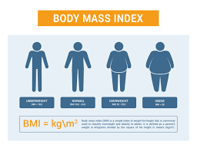
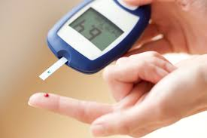

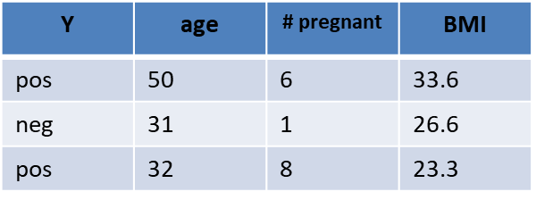
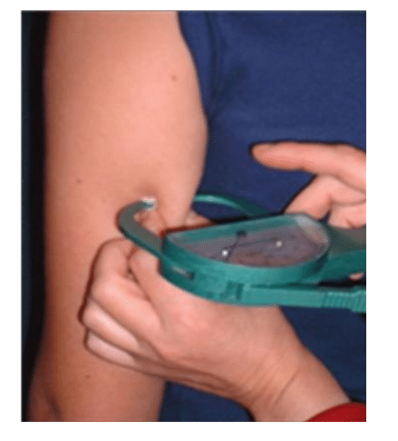
Regression
Curse of Dimensionality
What factors determine if a person has diabetes?
Pregnant
BMI
Age
Triceps Skin fold
Smoking. Genes,
alcohol addiction
Pregnant
BMI
Marriage, Transportation, House loan, Tax, several genes
Notes:
So here we present the concept of the curse of dimensionality. What are the factors that determine if the person has diabetes? The related factors can be the individual’s age, BMI, triceps skin fold, smoking, genes, and pregnancy. However, there are other factors such as marriage, house loan, tax, other several genes may not influence the outcome of whether a person has diabetes. So, we need to select the variables that are most significant for the purpose of the outcome. Bayesian shrinkage priors and penalized regression helps in addressing the reduction of variable dimensions.

Slide 7
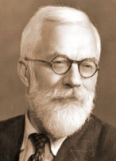
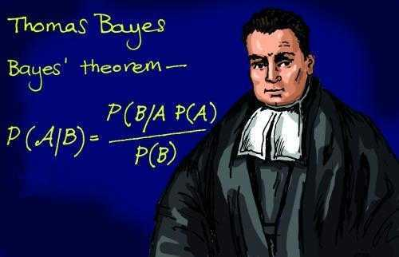
Tackling High Dimensions
Research Goal Simultaneously select important variables and achieve good predictions
Lasso,
Ridge Regression
Frequentist
Shrinkage Priors
Bayesian
Notes:
we have two schools of statistics. Frequentist methods developed by R.A Fisher who is considered as the father of modern statistics, and Bayesian Statistics developed by Thomas Bayes. The frequentist method is penalized regression such as lasso, ridge, etc. while the Bayesian counterpart is the shrinkage priors. The goal is to simultaneously select important variables and predictions.
Frequentist uses the data at hand and don’t assign probability to the unknown parameters while Bayesian uses prior information available to them along with the data at hand.
In case of variable selection, penalized regression techniques are very popular.
In frequentist setup curse of high dimensions is handled by methods like Lasso, Ridge , Elastic net while in Bayesian setup it is tackled by prior distributions called Shrinkage Priors.
Our goal is to simultaneously select important variables and achieve good predictions in the Bayesian paradigm.

Slide 8
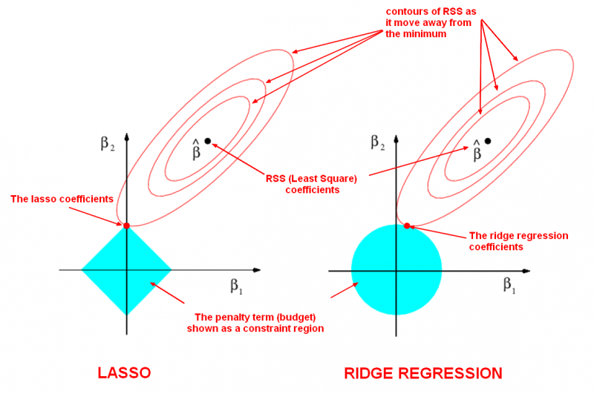

Penalized Regression
Penalty term that shrinks the coefficient estimates to zero
Ridge - $Likelihood+λ\sum_{j=1}^{p}{β_{j}^{2}}$
Lasso - $Likelihood+λ\sum_{j=1}^{p}{|β_{j}|}$
Elastic-net
Notes:
Here we describe the penalized regression. In penalized regression, there is a penalty term that acts as a shrinkage parameter. This is a form of regression, that constrains/ regularizes or shrinks the coefficient estimates towards zero
λ = 0, the penalty term has no eﬀect
λ→∞, the coeﬃcient estimates will approach zero
Here beta_hat is the least square estimate and the ellipses are the contour regions of the \beta_hat. In the case of the ridge regression, the constraint regions are in the form of a circle. The contour region cannot intersect at a single point, thus the parametes of the non-significant variables are shrunk towards zero but they are not exactly zero. In case of Lasso, the constraint region is in the form of rhombus. The lasso regression can cut at a particular point , thus making the parameter values of the non-significant variables exactly equal to zero. Elastic net is the linear combination of both lasso and ridge.

Slide 9

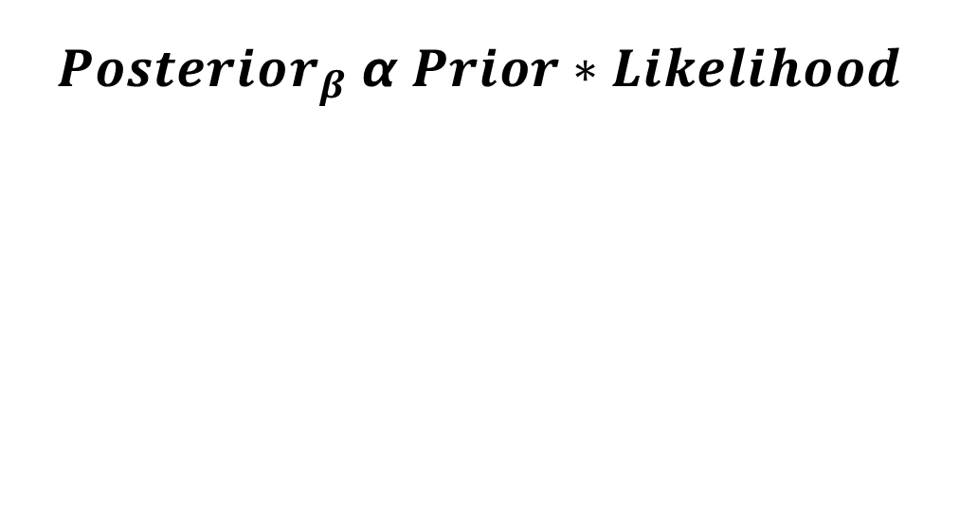
Model Fitting and Prediction
$$Posterior_{β} α Prior∗Likelihood$$
Posterior distribution
of $β$
Posterior distribution
of 𝛽
$$\hat{β}$$
Estimated coefficients
𝛽 ̂
Estimated coefficients
$$\hat{Y}$$
Predicted Response
𝑌 ̂
Predicted Response
Notes:
Now let us go through the Bayesian model fitting and prediction. In the Bayesian framework the posterior distribution of the parameter beta is proportional to the prior multiplied by likelihood. Once we obtain the posterior distribution, on the basis of the posterior Markov chain monte carlo simuations, we can get the estimated coefficients \betahat. We will calculate the response probability and choose a cut-off point which can be 0.5 or anything else depending on data, that will finally help us to predict the response. The posterior distribution helps to address the model diagnostics, predictions, posterior credible intervals, and all sorts of post-processing calculations can be done.

Slide 10
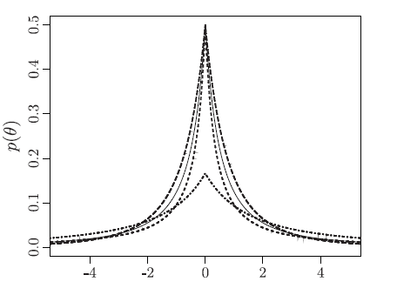
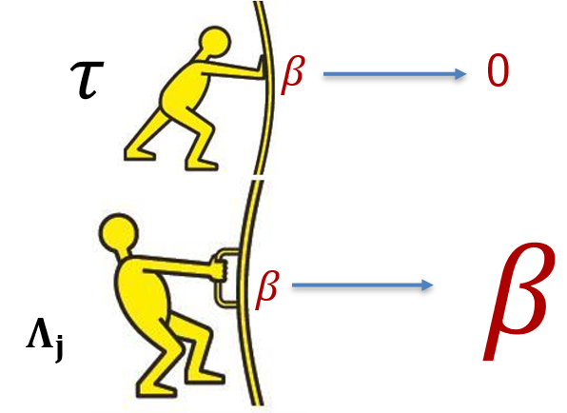
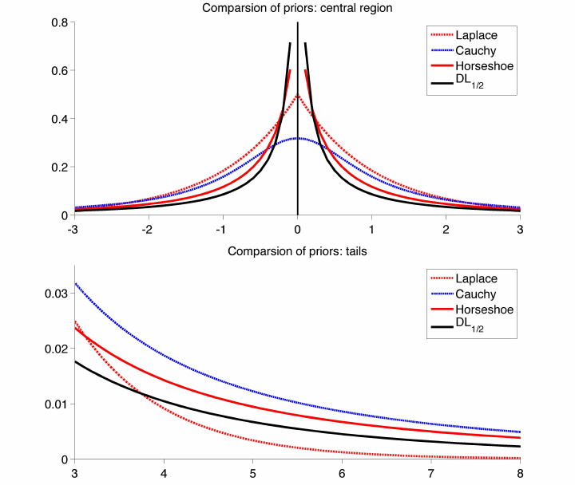
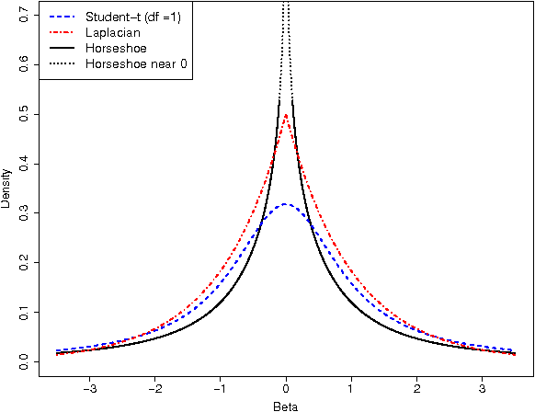

Bayesian Shrinkage Priors
Lasso estimate = Bayesian posterior mode estimate [Tibshirani, 1996]
Laplace prior for 𝛽 – Bayesian Lasso [Park and Casella, 2008]
Shrinkage Priors: Priors that keep large coefficients large, and shrinks small coefficients further, similar to the penalty term in Lasso
Global-Local Shrinkage Priors
$$β_{j}\sim N\left(0, Λ_{j}^{2}τ^{2}\right){ Λ}_{j}\sim f\left(.\right), τ\sim g\left(.\right)$$
f (·) - heavy tails, g (·) - substantial mass near zero
Double Pareto
Global-Local Shrinkage
Horseshoe
Dirichlet Laplace
Notes:
Tibshirani in 1996 mentioned that the lasso estimates can be equal to the Bayesian posterior mode estimates when the regression parameters have independent
and identical Laplace (double exponential) priors. Motivated by this several authors proposed laplace like priors. Our main focus will be on global-local shrinkage priors where priors that keep large coefficients large and shrinks small coefficients further similar to the lasso penalty.

Slide 11
Bayesian Shrinkage Priors
Objective function=Log likelihood+log(prior)
Bayesian counterpart
Prior playing the role of penalty.
priors are not limited within linear likelihood. Shrinkage can be applied to the non-linear or non-gaussian likelihood
Notes:
The objective function in the Bayesian counterpart is the loglikelihood +log(prior). Here the prior plays the role of the penalty. The priors are not limited within linear likelihood, shrinkage can be applied to the non-linear or non-gaussian likelihood. Now let me give you a history of the shrinkage priors.

Slide 12

Bayesian Lasso
Lasso estimate = Bayesian posterior mode estimate when
$β \sim$Laplace (i.e., Double-Exponential) priors.
Bayesian Lasso (Park and Casella, 2008)
$f\left(β | σ^{2}\right)=\frac{λ}{2\sqrt{σ^{2}}}e^{−\frac{λ|β_{j}|}{√σ^{2}}}$
Shrinkage Priors i.e. Priors that keep large coefficients large, and shrinks small coefficients further, act similarly as the penalty term in Lasso.
Notes:
As I was mentioning before, The Lasso estimate for linear regression parameters can be interpreted as a Bayesian posterior mode estimate when the regression parameters have independent Laplace (i.e., double-exponential) priors. Gibbs sampling from this posterior is possible using an expanded hierarchy with conjugate normal priors for the regression parameters and independent exponential priors on their variances. The Bayesian Lasso provides interval estimates (Bayesian credible intervals) that can guide variable selection.

Slide 13
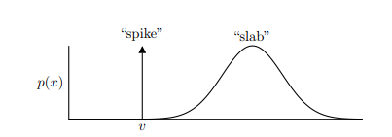
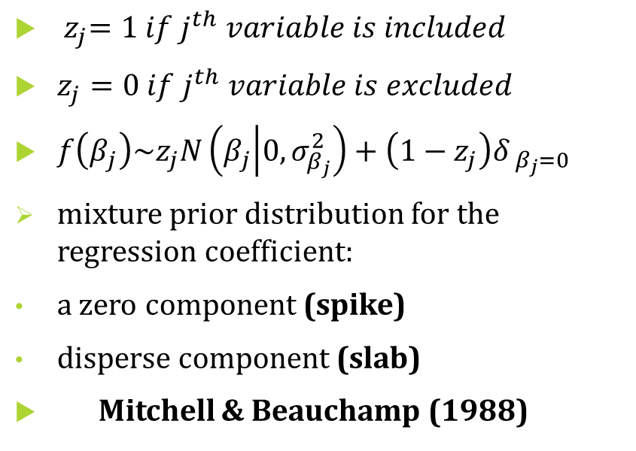
Spike and Slab Prior
${ z}_{j}=1 if j^{th} variable is included$
$z_{j}=0 if j^{th} variable is excluded$
$f\left(β_{j}\right)\sim z_{j}N\left(β_{j} | 0,σ_{β_{j}}^{2}\right)+\left(1−z_{j}\right)δ_{ β_{j}=0}$
mixture prior distribution for the regression coefficient:
a zero component (spike)
disperse component (slab)
Mitchell & Beauchamp (1988)
Notes:
Mitchell et, al in 1988 introduced the spike and slab prior. As the name suggests a spike and slab prior for a random variable X is a generative model—i.e., a prior—in which X either attains some fixed value, called the spike, or is drawn some other prior, called the slab. Here Zj=1 if the j the variable is included and Zj=0 if the jth variable is excluded. A zero component refers to the spike and dispersed component to the slab. In this picture, there is a spike at v and a gaussian slab. It is a mixture of the prior distribution for the regression coefficients. The posterior is hard to compute because it requires summing over the 2^n values that the random variable X can contain.

Slide 14
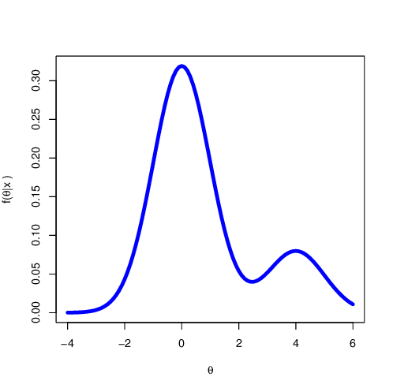
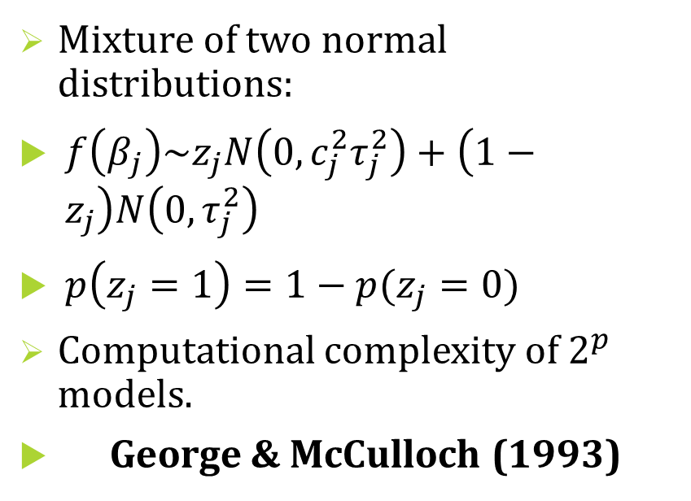
Stochastic Search Variable Selection
Mixture of two normal distributions:
$f\left(β_{j}\right)\sim z_{j}N\left(0,c_{j}^{2}τ_{j}^{2}\right)+\left(1−z_{j}\right)N\left(0,τ_{j}^{2}\right)$
$p\left(z_{j}=1\right)=1−p(z_{j}=0)$
Computational complexity of $2^{p}$ models.
George & McCulloch (1993)
Notes:
George et,al. in 1993 proposed the mixture of two normal distributions as the stochastic search variable selection. Here Zj =1 when the regression parameters follow N(0,c2tau 2) and Zj =0 when the regression parameters follow N(0, tau2). The Zj value follows Bernoulli distribution with probability p. Here are the variances are different in the normal setup. The basic idea of SSVS is to assign commonly used prior variances to parameters, which should be included in a model, and prior variances close to zero to irrelevant parameters. By that, relevant parameters are estimated in the usual way and posterior draws of irrelevant variables are close to zero so that they have no significant effect on forecasts and impulse responses. This is achieved by adding a hierarchical prior to the model, where the relevance of a variable is assessed in each step of the sampling algorithm.

Slide 15
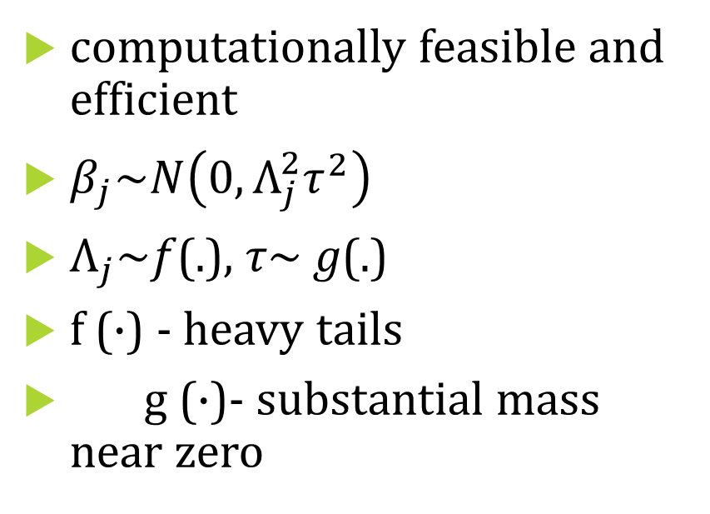
Global-Local (GL) Shrinkage Priors
computationally feasible and efficient
$β_{j}\sim N\left(0, Λ_{j}^{2}τ^{2}\right)$
$Λ_{j}$~𝑓(.), 𝜏~ 𝑔(.)
f (·) - heavy tails
g (·)- substantial mass near zero
Notes:
Now we focus on the global–local shrinkage priors. The priors are in this form. Here \lambda_j is the local parameter as lambda_j changes \beta_j changes and tau is the global parameter. It is expected that the local parameter \lambda_j follows a distribution that has heavy tails and the \global parameter \tau has distribution with substantial mass near zero. Global-local shrinkage priors have been recognized as a useful class of priors that can strongly shrink small signals toward prior means while keeping large signals unshrunk.

Slide 16
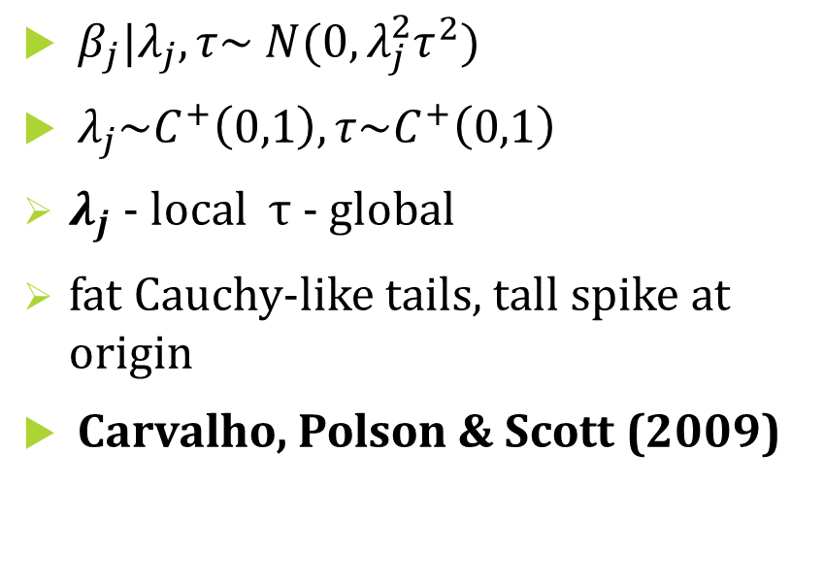
Horseshoe Prior
$β_{j}|λ_{j}, τ\sim N(0,λ_{j}^{2}τ^{2})$
$λ_{j}\sim C^{+}\left(0,1\right),τ\sim C^{+}\left(0,1\right)$
$λ_{j}$ - local $τ$ - global
fat Cauchy-like tails, tall spike at origin
Carvalho, Polson & Scott (2009)
Notes:
Among the global local shrinkage prior the most popular is Horseshoe prior. Read the slide. The order of peakedness near zero: HS+ ≈ DL > HS > Laplace

Slide 17
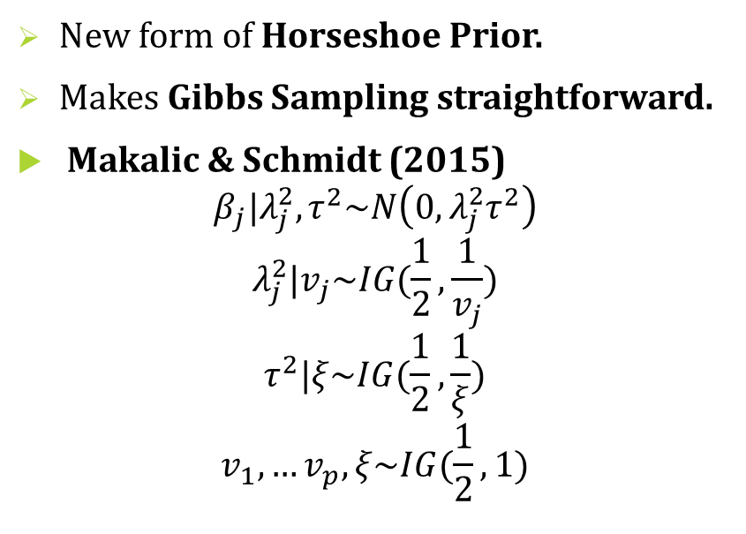
Horseshoe Prior
New form of Horseshoe Prior.
Makes Gibbs Sampling straightforward.
Makalic & Schmidt (2015)
$$β_{j}|λ_{j}^{2},τ^{2}\sim N\left(0,λ_{j}^{2}τ^{2}\right)$$
$$λ_{j}^{2}|v_{j}\sim IG(\frac{1}{2},\frac{1}{v_{j}})$$
$$τ^{2}|ξ\sim IG(\frac{1}{2},\frac{1}{ξ})$$
$$v_{1},…v_{p},ξ\sim IG(\frac{1}{2},1)$$
Notes:
Another form of Horseshoe prior that is popular is the form by Makalic et, al. This form makes the Gibbs sampling straightforward. We have used this prior in our models and calculations.

Slide 18
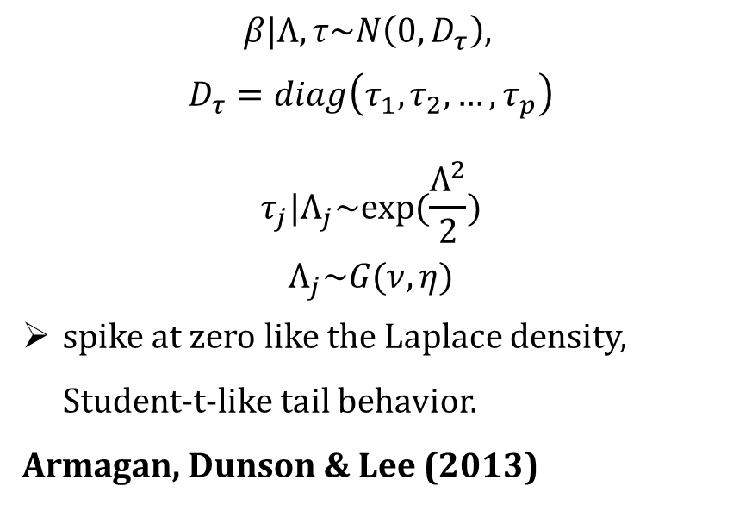
Double Pareto Prior
$$β|Λ,τ\sim N\left(0,D_{τ}\right),$$
$$D_{τ}=diag\left(τ_{1},τ_{2},…,τ_{p}\right)$$
$$τ_{j}|Λ_{j}\sim exp⁡(\frac{Λ^{2}}{2})$$
$$Λ_{j}\sim G(ν,η)$$
spike at zero like the Laplace density, Student-t-like tail behavior.
Armagan, Dunson & Lee (2013)
Notes:
Double Pareto prior is another form of global local shrinkage prior developed by Armagan et al. in 2013. The priors has spike at zero like the laplace density and student t-like tail behavior.

Slide 19
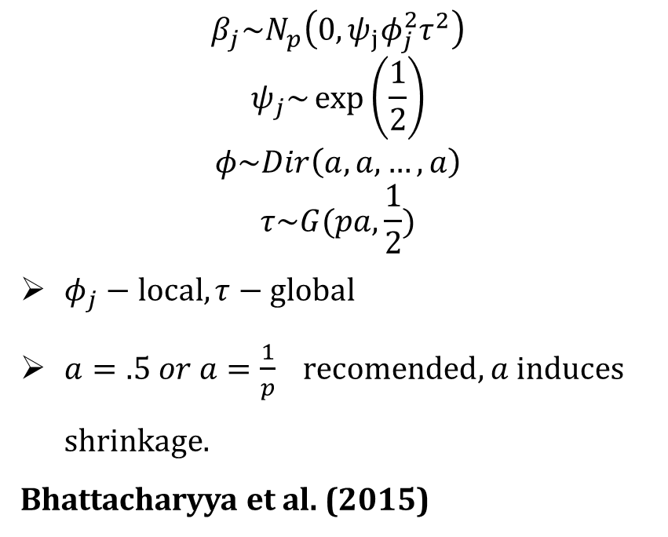
Dirichlet Laplace Prior
$$β_{j}\sim N_{p}\left(0,ψ_{j}φ_{j}^{2}τ^{2}\right)$$
$$ψ_{j}\sim \exp\left(\frac{1}{2}\right)$$
$$φ\sim Dir\left(a,a,…,a\right)$$
$$τ\sim G(pa,\frac{1}{2})$$
$φ_{j}−local, τ−global$
$a=.5 or a=\frac{1}{p} recomended, a$ induces shrinkage.
Bhattacharyya et al. (2015)
Notes:
Dirichlet prior is another form of global local shrinkage prior proposed by Bhattacharyya et.al, in 2015. The results depend on the parameter a =0.5 and a =1/p a induces shrinkage.

Slide 20
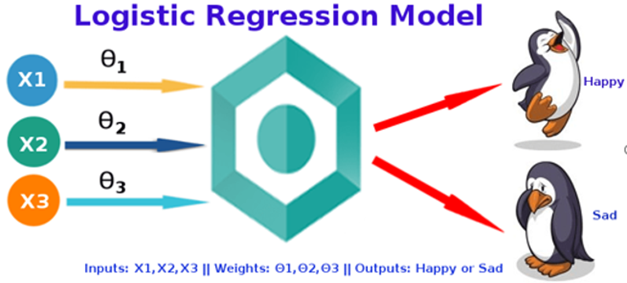
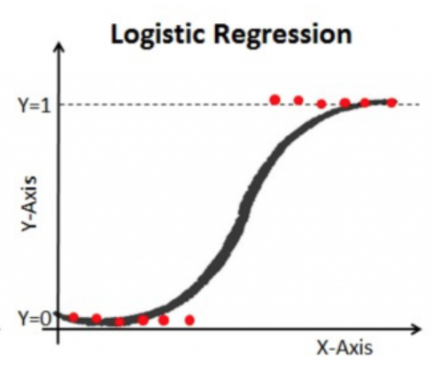

Categorical Response Models
$Y_{i}\sim Bin \left(1,p_{i}\right), p_{i}=\frac{exp\left(x_{i}^{T}β\right)}{1+exp(x_{i}^{T}β)}$
$\log\left(\frac{p_{i}}{1−p_{i}}\right)=β_{1}X_{1}+…+β_{p}X_{p}$
$β\sim f\left(.\right)−Prior information$
Multinomial Logistic regression for > 2 classes
Notes:
Our main focus is on the categorical and counts data models, mainly Logistic regression and negative binomial regression since linear regression has been covered extensively in the literature. Let me give you a refresher on logistic regression. Here Y is the binary outcome with two values 0 or 1. Y ~Bin(1, with probability p_i). There is a link function called logit function that coordinates with the Predictor variables X_1, X_2, ,…., X_p and the coefficients \beta1_, \beta_2, are given a prior information. Here in our case we apply the global-local shrinkage priors such as Horseshoe, DL or Double pareto. In case of Multinomial logistic regression, we have more than 2 classes in the outcome variable.

Slide 21
Bayesian Paradigm for Count/Categorical Data
Dataset with categorical response/ count response
Prior Information
Posterior Samples by MCMC
Posterior credible intervals for Variable Selection
Polya-Gamma Data Augmentation
Prediction Performance – Accuracy, Sensitivity, Specificity, Brier Score, AUC-ROC, MSE
Notes:
The Bayesian paradigm will go like this. First, we need to have a dataset with categorical or count responses; we use a data augmentation technique that I will come in my later slides to address the intractability in the likelihood. The Prior information is also provided. Then posterior samples are obtained. Using the MCMC samples, we obtain the posterior credible intervals If the credible intervals include zero, we consider that variable to be not significant, while if the credible interval does not include zero, then that variable is considered to be significant. Finally, we evaluated the prediction performance through accuracy, sensitivity, specificity, etc.

Slide 22
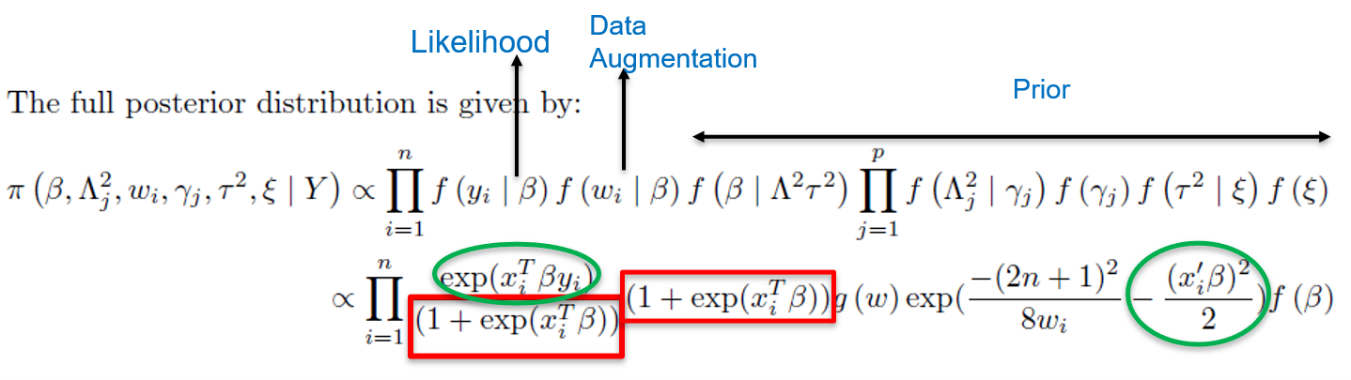
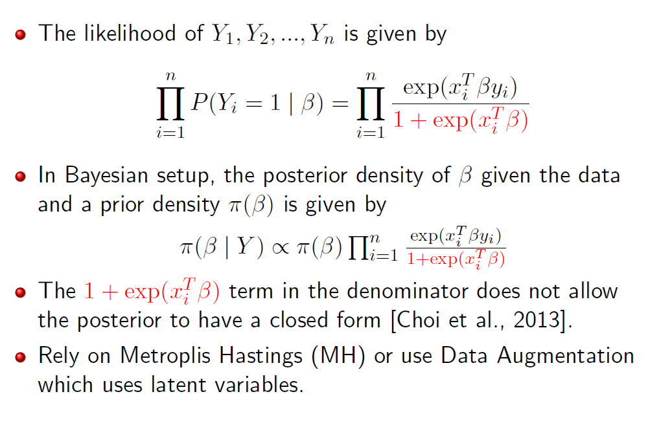
Logistic Regression with Shrinkage Priors
Need to sample from an intractable density
Data Augmentation = Posterior distributions in closed form, Gibbs Sampling
Notes:
Here are the details for logistic regression with shrinkage prior and polya gamma data augmentation. The full posterior distribution is shown here. We see that the likelihood of the logistic regression is intractable. Upon using the polya gamma data augmentation, we find that the denominator of the likelihood gets canceled as highlighted in red. The green sections together help to form a normal distribution for the beta. Thus, the posterior densities of beta given w and w/ beta are in closed form. Here w is the latent variable or the polyagamma variable.

Slide 23
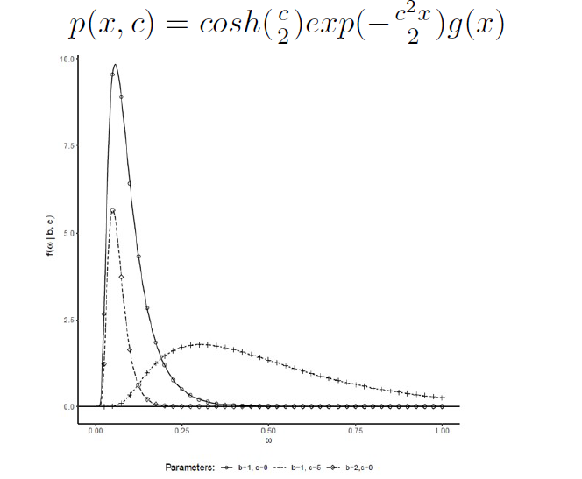

Polya-Gamma Data Augmentation
Need to sample from an intractable density f(θ)
Introduce a latent variable V such that $\int{f\left(V,θ\right)dv=f(θ})$
f(V| θ) & f(θ|V) are easier to sample.
Polya-gamma PG (1,c) distribution takes the form
Notes:
No let me give a brief overview of the polya gamma data augmentation. Read the slide. Here is the form of the PG distribution that we have used.

Slide 24
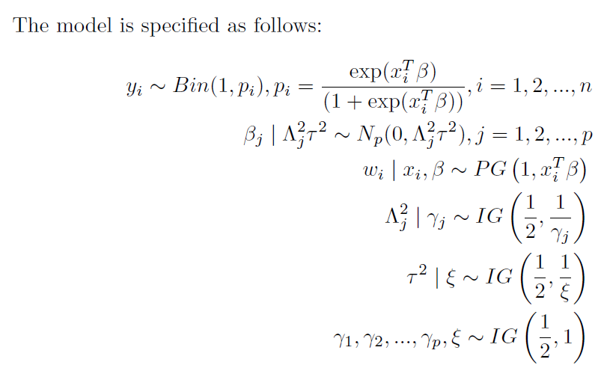
Posterior Distribution with Horseshoe and Polya Gamma in Logistic Regression
Notes:
This is one of the example models. Here we have logistic regression. And the beta_j follows the global-local shrinkage priors and with a polyagamma data augmentation step. And the rest of the hyperparameters of the horseshoe prior follow the IG distribution. From this we obtain the posterior distributions as follows.

Slide 25
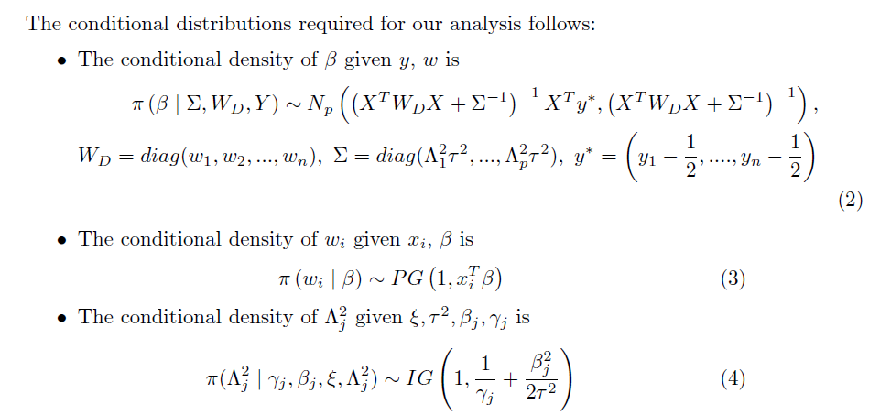
Conditional Distributions
Notes:
Here we see that the conditional posterior distributions follow Normal distribution. The Polya gamma variable follows PG(1, xTbeta) The hyperparameters follow inverse gamma distributions

Slide 26
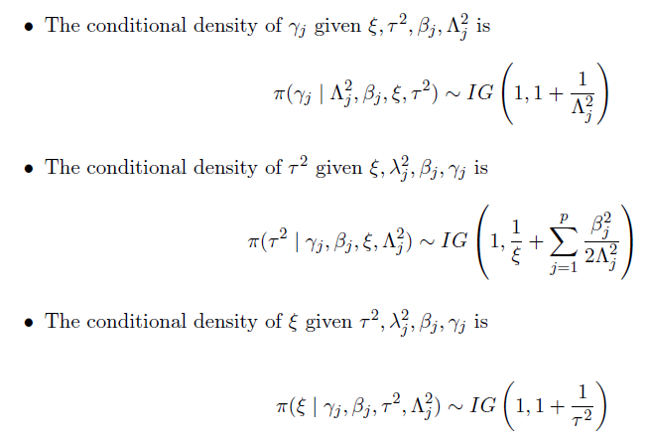
Conditional Distributions
Notes:
Rest of the hyperparameters follows inverse gamma distributions.

Slide 27
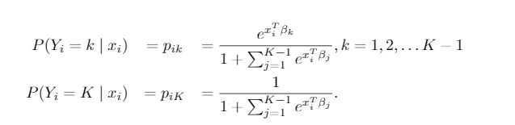
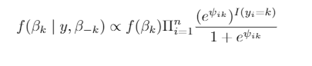
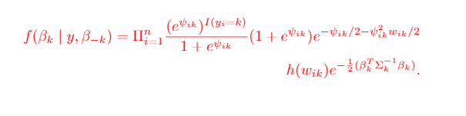
Multinomial Logistic Regression with Shrinkage Prior
Model
Full conditional with shrinkage prior for coefficients of each class
Posterior distribution for each class with data augmentation and shrinkage priors on β
Notes:
This is the form of the multinomial logistic distribution. Here the response variable has more than two classes. This is the extension of the binary regression, where the outcome variable has more than two classes. Here, $\beta_k$ are the coefficients associated with $k$-th category, and $K$ is the baseline category with its coefficient $\beta_K$ constrained to zero. The Polya-Gamma data augmentation approach can be extended for multi-category response variables. Here, $\beta_k$ is updated conditional on the remaining $\beta_{-k} which doesn’t contain the coefficient for the Kth class. This is a logistic regression likelihood, thus PG data augmentation can be implemented to update each of $\beta_k$'s based on the binary indicator variable $I(y_i=k)$, i.e. for each class.

Slide 28
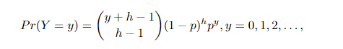
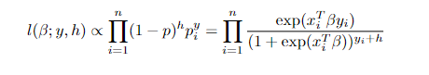
Negative Binomial Regression with Shrinkage Priors
Model
Likelihood
Shinkage priors with PG augmentation
Notes:
The likelihood of the negative binomial regression in this form. To facilitate posterior sampling, we now introduce a set of auxiliary variables that follow Polya-Gamma distribution represented as scale mixtures of Normals. We denote a Polya-Gamma variable by w ∼ P G(b, c) with b > 0 and c ∈ R. The variable distribution is similar to Gamma distribution, and, as b increases, it becomes approximately normal. Conditional on the latent variables, inference can proceed via direct Gibbs sampling from standard distributions. The augmentation trick works while especially modeling proportions on the log-odds scale.

Slide 29
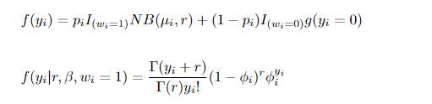
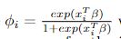
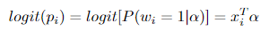
Zero-Inflated Negative Binomial Regression with Shrinkage Priors
Model
Likelihood
Shrinkage priors on both α and β and data augmentation for both the parts.
Notes:
Zero-inflated models are specifically suited to datasets appearing with an over- abundance of zeros. Such excess of zeros and the resulting over-variation may not be accounted properly for by NB or Poisson models. By construction, zero-inflated models partition zeros into two types. The first type, typically referred to as a “structural” zero, corresponds to individuals who are not at risk for an event and therefore have no opportunity for a positive count. The second type, termed the “at-risk” or “chance” zero, applies to a latent class of individuals who are at risk for an event but nevertheless have an observed response of zero. The zero-inflated model treat these two types of zeros as latent variables. It imposes a logistic distribution to model the proportion of structural zeros and a negative binomial to model the count part. Both the logistic and negative binomial likelihoods are not amenable forms and require data augmentation steps to have conditional distributions to facilitate sampling. Keeping the prior distributions same as in case of logistic regression and negative binomial regression, we get the same posteriors as of logistic regression and negative binomial regression.

Slide 30





Results on Simulated Data
Notes:
Now we will focus on the results of simulated data. If you have any questions until now, please let me know. From here on, Dr. Mitra will be teaching the course.

Slide 31
Prediction Module
Data
Training & Test Data
Fit the models with Training Data
Predict response with test data
Prediction Intervals for variable selection
Accuracy, Sensitivity, Specificy, AUC-ROC for prediction
Notes:
Here is the prediction module. We divide the data into training and testing sets, then fit the models in the training dataset, and finally predict the response with the test data. After model fitting variable selection was implemented by computing their posterior credible intervals. Posterior credible intervals can be readily obtained from a Bayesian framework via MCMC samples, and can provide direct uncertainty measures irrespective of model complexity. Specifically, these intervals are constructed by the quantiles of the MCMC samples of the parameters and estimate the probability intervals of the true posterior distribution. The confidence level of the credible bands was chosen to be 95%.The variables are declared to be significant if and only if these posterior credible interval do not include zero. Thus, it will be a binary vector of the variables that were selected from estimation. These binary estimates were then matched against the simulation truth to compute some performance metrics. Other than performance measures, these credible interval techniques would also provide a convenient measure of uncertainty, in case we need to use them. The varying sizes and noise content of datasets gets reflected in the varying lengths of the estimated prediction intervals that in turn allows us to place varying degrees of confidence in our inferred relationships. This could also inform us about the desired adequacy of sample size and number of variables for future studies. This can be readily obtained from MCMC samples unlike other traditional methods such as Lasso.

Slide 32
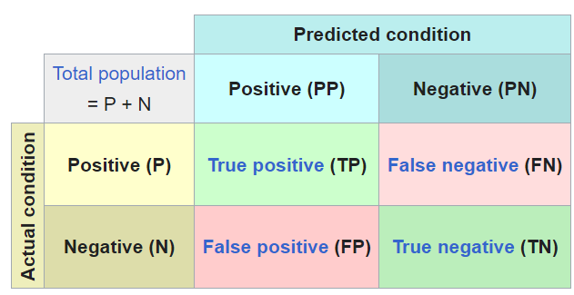
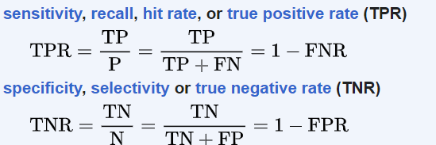
Confusion Matrix
Notes:
Based on the binary estimates, sensitivity, specificity, and overall accuracy were computed for variable selection. We calculate a confusion matrix which is a special kind of contingency table, with two dimensions ("actual" and "predicted"), and identical sets of "classes" in both dimensions. From here, we calculate the sensitivity, specificity, and accuracy. A prediction module was also added that would assess how the model fares in classifying the responses. For this, a cross-validation approach is undertaken and divided each simulated data set into training and test data on a 80-20 allocation percentage. The following measures were used for assessing the quality of our prediction. Accuracy (the proportion of correctly classified responses in the test dataset); Sensitivity ( proportion of true positives ); Specificity ( proportion of true negatives ); AUC ( Area Under the Receiver Operating Characteristic (ROC) Curve ).

Slide 33

Brier Score
The Brier score is a score function that measures the accuracy of probabilistic predictions.
$p_{i_{pred}}−predicted probability , y_{i}−original outcome$.
Smaller the better.
𝐵𝑆=0 best score, 𝐵𝑆=1 worst score
$BS=\frac{1}{n}\sum_{i=1}^{n}{{\left(p_{i_{pred}}−y_{i}\right)}^{2}}$
Notes:
Another measure called the Brier score was also calculated. Read the slide.

Slide 34
Simulation Scenarios
Data was simulated with variable no. of predictors and sample sizes.
Several set of coefficients were explored.
Model can have unpenalized baseline variables, and differential shrinkage.
Interaction terms between proxied biomarker variables and demographics were considered.
Logistic-codes.html
Negbin-Codes.html
Notes:
Data was simulated under various settings of sample size ($n$), dimensions ($p$), and effect sizes $\beta = (\beta_1,\beta_2,\ldots,\beta_p)$. The continuous covariates are simulated from normal distribution with mean $m$ and $sd = 1$. A total of 100 data sets were simulated for each of the conditions. All computations are carried out in R \cite{R:2020}. The length of the Markov Chain Monte Carlo (MCMC) simulation is $10000$, and $6000$ iterations are discarded in the burn-in step.

Slide 35
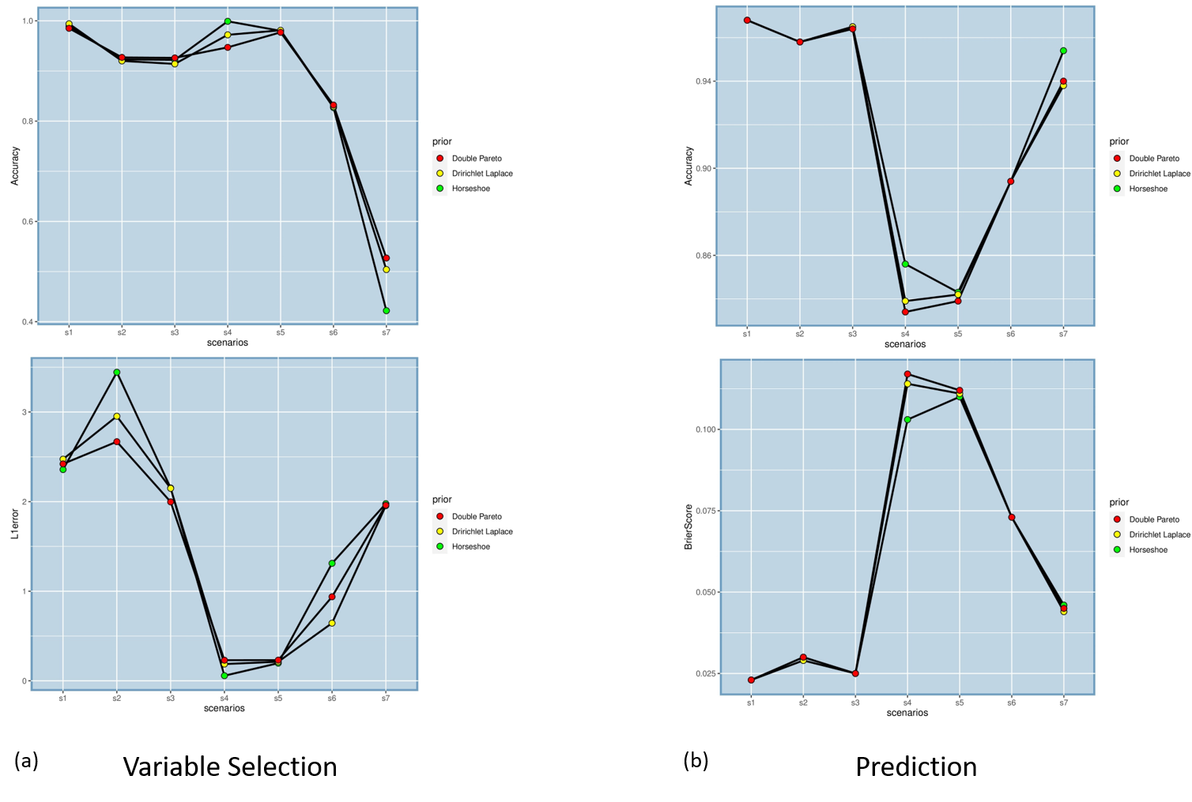
Simulation: Logistic Regression
Accuracy
Mostly metrics in the range of 0.8-0.9
Sample size increases the measures, except Brier score
Better performance on sensitivity and specificity
p>n case – prediction metrics stayed in 0.8 range
Trend continues for differential shrinkage and models with interaction terms
Brier Score
Notes:
The primary takeaway from the results is that performance metrics reach increasingly higher levels with higher sample size/ no. of variables (N/P
) ratio and higher magnitude of the coefficients. For LR, a large part of these numerical measures lie in the range of 0.8-0.9, and the trend also continues in the simulation settings with differential shrinkage and interaction coefficients. A higher correlation among the variables and a higher percentage of zero $\beta's$ does drop the performance to some extent. Overall, the proposed method does markedly better on specificity than sensitivity. Even in the $p> n$ scenario, most of our performance metrics stayed above 0.8 for both prediction and variable selection. Here in the graphs, we see the accuracy and L1 error for variable selection of different 7 simulation scenarios, and the accuracy and brier score for prediction.

Slide 36
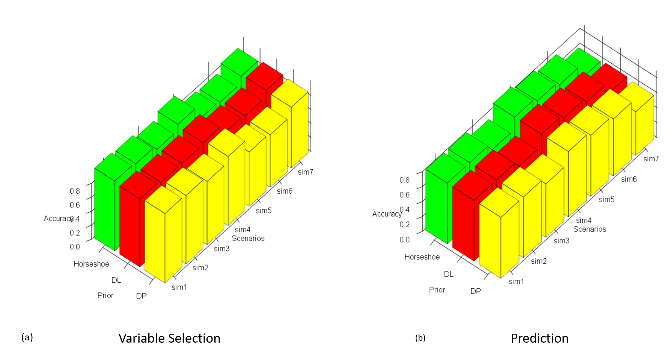
Simulation: Multinomial Logistic Regression
Accuracy
Large sample sizes drive better performance
Overall performance in the range of 0.85-0.9
More no. of classes, and proportion of zeros in coefficients impact the predictive measures
Notes:
for MLR, larger sample size, as before drives better performance. The predictive performance, in contrast, is moderate compared to the counterpart for LR, though the prediction accuracies remain above 0.8 in 4 out of the 7 simulation settings. It is seen that a larger number of classes, ie. (5 classes), reduces the predictive measures to the range of 0.7-0.8. The performances were very similar across all three priors for variable selection as well as prediction, so the method is robust to prior choices. Here in the graph, we see the accuracy of variable selection and prediction for 7 distinct simulation scenarios. The green, red and yellow bars denote the Horseshoe, DL and DP priors.

Slide 37
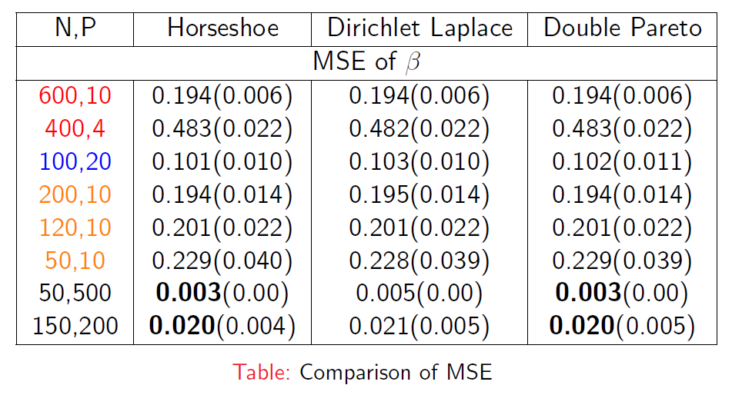
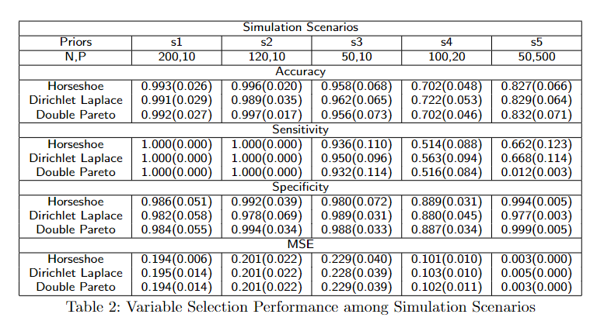
Simulation: Negative Binomial Regression
Similar trend of decrease in MSE with increase in n and p
The p>n case also have significantly reduced MSE, and performs well in selecting variables.
The variable selection performance for all the case achieves >99% on every measures, and low MSE.
Notes:
Next, we show the results for negative binomial regression. Table shows the variable selection performances assessed through MSE along with their standard deviations for the BNB model. The performance measures of S1, S2, and S3 were similar. We find an increasingly good performance with increasing sample sizes in terms of variable selection measures with the corresponding MSEs naturally having the exact opposite trend. S1 and S2 has 100\% sensitivity implying that all the non-zero $\beta$ can be identified. There was not much of an impact of correlation settings on the results. The most noteworthy result is that for scenario S5 which is truly a high-dimensional setting with $p$ much larger than n. We see that the methods perform very well (and even superior to low-dimensional settings) in terms of specificity and mean-squared errors with only a modest sacrifice in sensitivity and overall accuracy. The latter still remain above 80 percent for all three priors. Since controlling false positives are a big concern in high-dimensional biomedical scenarios, this result points strongly to the applicability of our method in $p>n$ regressions in count data. In all the above $n>p$ scenarios we see that Horseshoe, and Double Pareto perform distinctly better than Dirichlet Laplace.

Slide 38
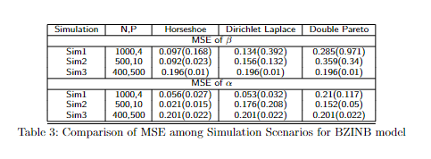
Simulation: Zero-Inflated Negative Binomial
Reduced MSE for β with increase in sample size
No pattern seen in the MSE of α
All the three priors perform similarly for p>n case
Notes:
For the BZINB model, Horseshoe prior clearly outperforms the other two priors across the simulation scenarios. The $p>n$ case yields similar performances across all three priors in Table. We calculate the MSEs for the alpha’s coming from the logit part and beta’s from the negative binomial regression part.

Slide 39
Application to Datasets with Binary/ Multinomial Outcomes
Diabetes
Colon Cancer
Alzheimer’s disease
Notes:
The method is validated by applying it to standard data examples. For all case studies, MCMC burn-in size is 6000, and no. of MCMC iterations is 10000. The training and test set size is of ratio $80/20$. We will show the analysis of three datasets related to diabetes, colon cancer and Alzheimer’s disease.

Slide 40
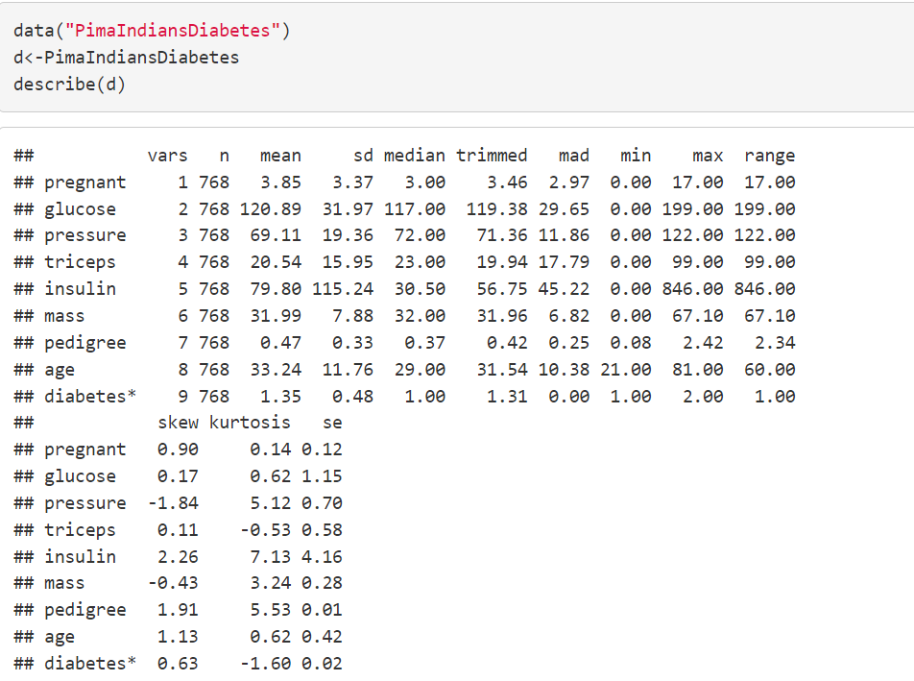
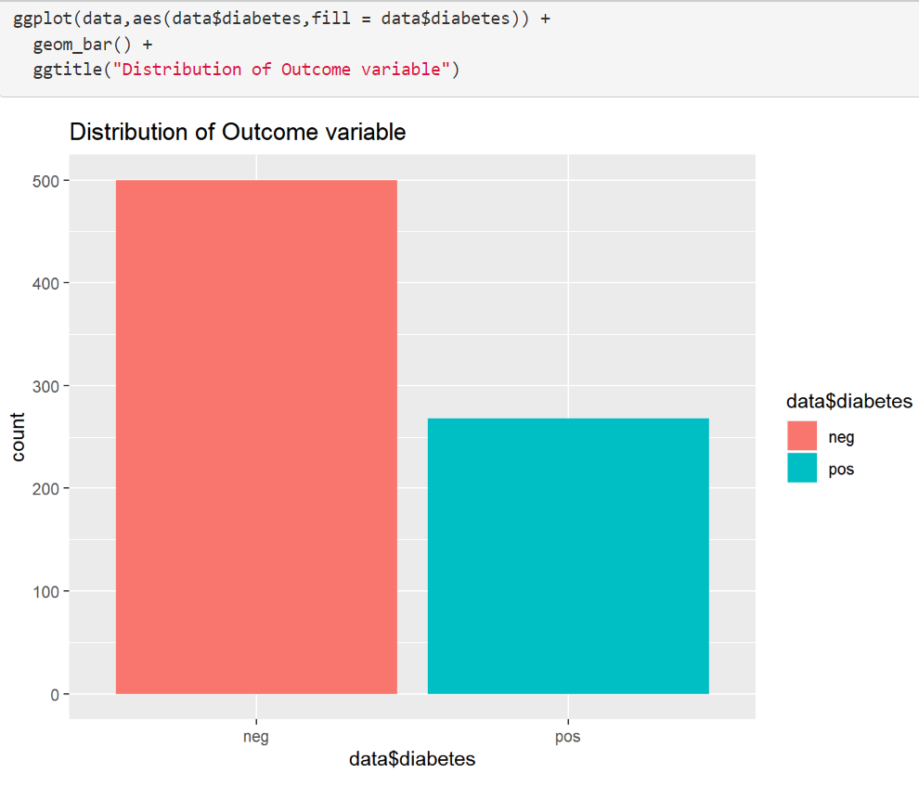
Logistic Regression Case Study
Pima Indian Diabetes Data
Notes:
This is the cased study of the logistic regression. The data is PimaIndiansDiabetes data set, where the variables that predict the diabetes outcome are pregnancy, glucose level. Pressure, triceps, insulin, mass, pedigree, and age.The three priors can detect four variables by 95\% credible intervals. The credible intervals of the coefficients with variable names "pregnant," "glucose," "mass (BMI)," and "pedigree (family history)" do not include zero; hence they are significant. These results are at par with literature Makalic et.al. the "pressure" variable is also determined as significant by DP prior. These three priors are also compared with Bayesian-Lasso(Blasso) Bayesian-Elastic-Net(BElastic) and frequentist methods like Lasso , Elastic-Net and Ridge . Here, the three priors' accuracy is similar, but BS is the least among all methods. Even though EN and Ridge have high accuracy, the frequentist methods have substantially high BS and low specificity values.

Slide 41
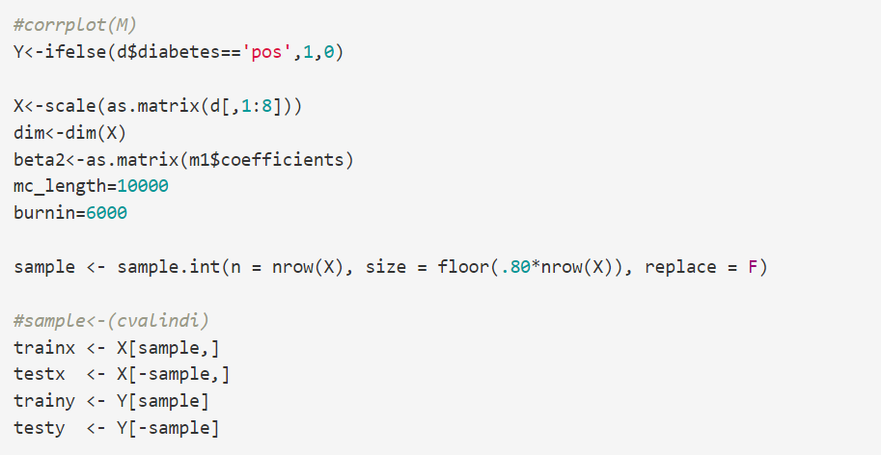
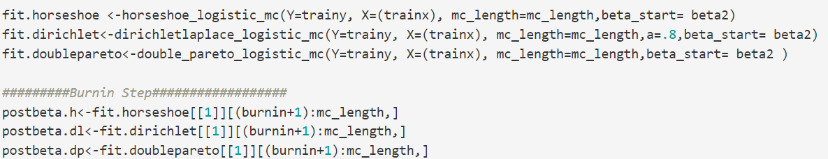
Pima Indian Diabetes Data
markdownPima.html
Notes:
Show the pima Indian diabetes html file.

Slide 42
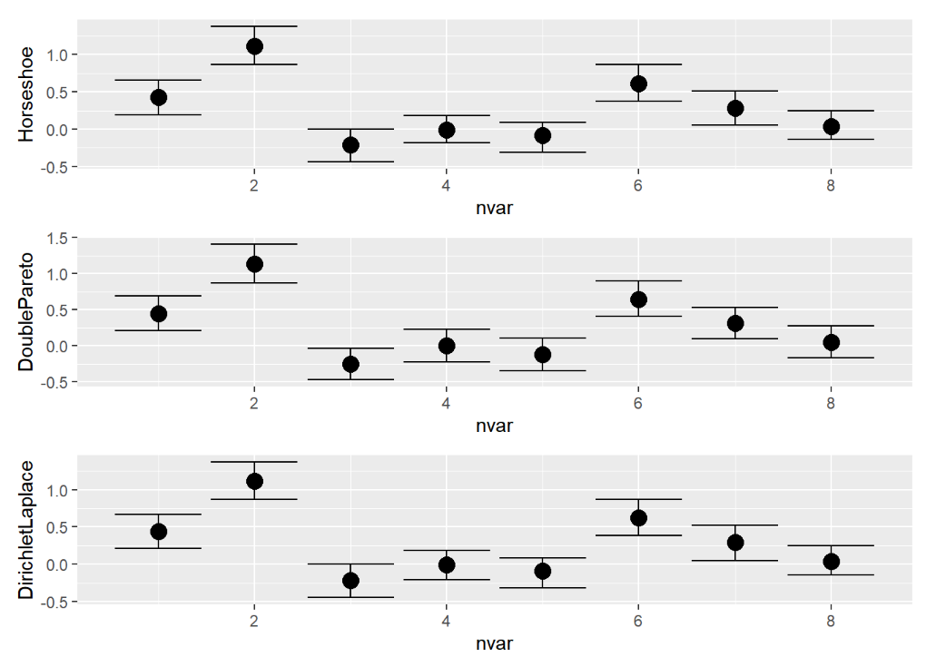
The three priors can detect four variables by 95% credible intervals. The credible intervals of the coefficients with variable names “pregnant,” “glucose,” “mass (BMI),” and “pedigree (family history)” do not include zero; hence they are significant. the “pressure” variable is also determined as significant by DP prior.
Notes:
After model fitting variable selection was implemented by computing their posterior credible intervals. Posterior credible intervals can be readily obtained from a Bayesian framework via MCMC samples, and can provide direct uncertainty measures irrespective of model complexity. Specifically, these intervals are constructed by the quantiles of the MCMC samples of the parameters and estimate the probability intervals of the true posterior distribution. The confidence level of the credible bands was chosen to be 95\%. The variables are declared to be significant if and only if these posterior credible interval do not include zero. Thus, it will be a binary vector of the variables that were selected from estimation. These binary estimates were then matched against the simulation truth to compute some performance metrics. Other than performance measures, these credible interval techniques would also provide a convenient measure of uncertainty, in case we need to use them. The varying sizes and noise content of datasets gets reflected in the varying lengths of the estimated prediction intervals that in turn allows us to place varying degrees of confidence in our inferred relationships. This could also inform us about the desired adequacy of sample size and number of variables for future studies. This can be readily obtained from MCMC samples unlike other traditional methods such as Lasso. Read the slide

Slide 43
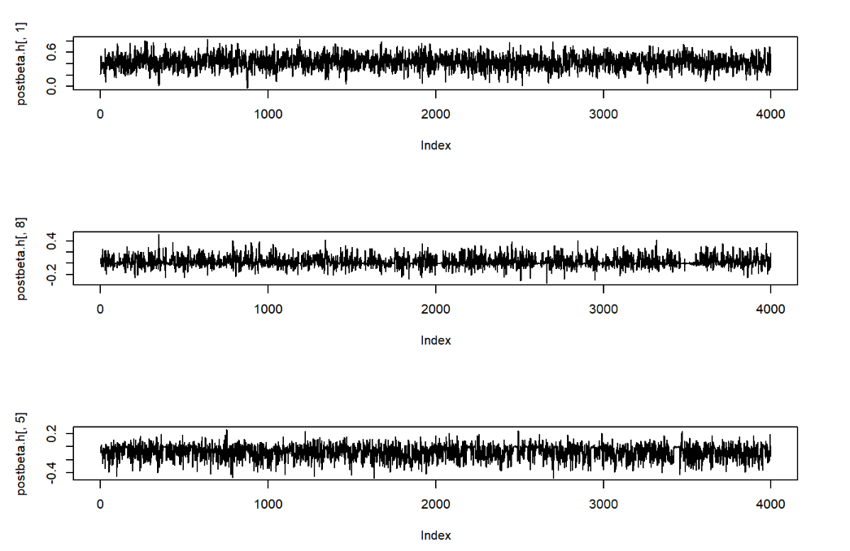

Diagnostic Plots
Notes:
Trace plots and AC plots are used to understand the convergence of the MCMC samples. They were reasonable in the case of all the datasets. The MCMC Gibbs sampling mixing and convergence were determined by trace plots and auto-correlation plots

Slide 44



Variable Selection & Prediction for Pima Indian Diabetes Data
Notes:
A prediction module was also added that would assess how the model fares in classifying the responses. For this, a cross-validation approach and divided each simulated data set into training and test data on a 80-20 allocation percentage. The following measures were used for assessing the quality of our prediction. Accuracy (the proportion of correctly classified responses in the test dataset); Sensitivity ( proportion of true positives ); Specificity ( proportion of true negatives ); AUC ( Area Under the Receiver Operating Characteristic (ROC) Curve ). Here, the three priors' accuracy is similar, but BS is the least among all methods. Even though EN and Ridge have high accuracy, the frequentist methods have substantially high BS and low specificity values.

Slide 45

36 genes were chosen by Horseshoe prior. DL prior chose 164 genes DP selected 67 genes
Measures | Horseshoe | Dirichlet Laplace (DL) | Double Pareto (DP)
Accuracy | 0.846 | 0.769 | 0.769
Sensitivity | 1.000 | 0.750 | 0.750
Specificity | 0.778 | 0.778 | 0.778
AUC | 0.889 | 0.764 | 0.764
Brier Score | 0.121 | 0.224 | 0.240
Notes:
This data comprises of gene expression levels for 40 tumors and 22 normal colon tissues measured for 6500 human genes using the Affymetrix oligonucleotide arrays Alon et, al.1999. Samples are obtained from tumor tissue and adjacent unaffected parts of the colon of the same patients. Out of these, 2000 genes with the highest minimal intensity across the tissues were selected for classification purposes. In the public domain, there is no demographic information available for the two groups like race, age, sex distribution; else, a study could have been conducted about the benefits of inclusion of one or all these covariates in prediction. Lasso selects 12 genes. The priors are applied to the data with the lasso estimates as the initial values. In the case of Horseshoe prior, it selects 36 genes with the highest frequencies, among which one gene (gene ID: 1423) is included among the top 20 genes selected by the t-test and fold change. Also, the gene ID: 1325 selected by Lasso \cite{Algamal:2017} can be seen in the set of 36 genes selected by Horseshoe. DL prior selects 164 genes, of which gene ID: 138 is included in the top 2 genes. DP selects 67 genes, out of which eight genes are in the set of genes selected by Horseshoe. On the basis of accuracy, sensitivity, specificity, AUC, and Brier score Horseshoe prior performs better than the rest.

Slide 46

Predictors
Diabetes: pregnancy, BMI, pedigree, family history
Alzheimer’s Disease: cognitive scores, verbal learning test scores, Age, Education, Socio Economic Status, Mini-Mental State Exam, and normalized Whole Brain Volume
Colon cancer: >=36 genes
Our proposed method with the horseshoe prior outperformed the frequentist methods on specificity by as much as 10 percentage points in all datasets. The colon dataset has the second highest AUC from our method only superseded by Blasso.
HS: Horseshoe, EN: Elastic-Net, DP: Double Pareto, DL: Dirichlet Laplace, BL: Bayesian Lasso, BEN: Bayesian Elastic Net
Notes:
Alzheimer's disease (AD) is a critical public health concern throughout the world and one of the most widespread neurodegenerative disorder. AD is an irreparable brain disease, which impairs thinking and memory. Several machine learning methods have helped predict AD from Mild Cognitive Impairment (MCI); The participants is divided into five different classes, namely, Cognitively Normal (CN $= 4428$), Early Mild Cognitive Impairment (EMCI $= 2687$), Late Mild Cognitive Impairment (LMCI $= 4993$), Subjective Memory Complaint (SMC $= 938$), and Alzheimer’s Disease (AD $= 1654$). here, the shrinkage priors are used to predict AD from MCI, and they achieve high prediction measures.\\This dataset is obtained from Alzheimer’s Disease NeuroimagingInitiative (ADNI) database. The three priors achieve 85\% accuracy and 93.5\% specificity for the prediction of AD from the MCI stage and have comparable results with other shrinkage priors. The results also indicate that the most distinguishing attribute for the prediction of AD includes the ADAS13.bl (13 item AD Cognitive Scale score), RAVLT.perc.forgetting.bl (Rey's Auditory Verbal Learning Test scores for immediate response learning, forgetting and percentage forgetting)) by all three priors. FAQ.bl (Functional Activities Questionnaire) cognitive test was selected only by DP prior. the circular bar chart Figure gives a detailed view of the prediction performance of LR model. This Figure is efficient in describing the comparison of all the four data sets in a single platform. For each data set, eight bars correspond to the eight shrinkage methods, and each stacked bar consists of the five measures of prediction. For ADNI and PIMA, all methods perform similarly, though the priors do not prove to be efficient in the high-dimensional Colon data.

Slide 47


Negative Binomial Case Study Biochemists data
Biochemists: Gender (x1), marital status (x2), the number of children under age six (x3), prestige of Ph.D. program (x4), and the no. of articles by the mentor in last three years (x5). Y: No. of PhD publications
Notes:
Now we will explain the negative binomial case study.This data deals with the number of publications produced by Ph.D. biochemists of \cite{Long:1990}. The data is available in the R package "pscl”.The response variable is the number of articles in the last three years of Ph.D. Five explanatory variables were used. They are: the gender $(x_1)$, the marital status $(x_2)$, the number of children under age six $(x_3)$, prestige of Ph.D. program $(x_4)$, and the number of articles by the mentor in last three years $(x_5)$. In this application, the response variable is following NB distribution. $(x_3)$ and $(x_5)$ were selected by the Bayesian methods.

Slide 48


Fitting a Negative Binomial Model in R
biochemists.html
Notes:
Open the html file

Slide 49

Variable selection for Biochemists Data
The no. of children under age six (x3) and the no. of articles by the mentor in the last three years (x5) were the most significant variables.
Notes:
Read slide

Slide 50


Model Diagnostics
Notes:
Model diagnostics show that the trace plots and autocorrelation plots are reasonable.

Slide 51


Biochemists Data Results
Biochemists: Gender (x1), marital status (x2), the number of children under age six (x3), prestige of Ph.D. program (x4), and the no. of articles by the mentor in last three years (x5). Y: No. of PhD publications
Notes:
The NB, poisson followed by BNB methods were suitable for the data set, as per the MSE of fitted values.

Slide 52
Discussion
The model relies on linking Polya-Gamma Data-Augmentation and Shrinkage Priors.
Algorithm is efficient.
Simulation studies and data results show that our method is competitive against traditional methods and also avoids over-fitting.
All three priors can be used for robust prediction with significant metrics, irrespective of their categorical response model choices.
Model can be applied to any regression settings.

Slide 53
Future Work
Extension with other shrinkage priors
Application to a real-world clinical trial design
Make the R codes public as an R package.

Slide 54
Acknowledgement
Dr. Riten Mitra*
Dr. Shesh N. Rai*
Dr. Subhadip Pal*
*Department of Bioinformatics & Biostatistics, University of Louisville, KY

Slide 55
References
Park, T., & Casella, G. (2008). The Bayesian Lasso. Journal of the American Statistical Association.
Polson, N. G., Scott, J. G., and Windle, J. (2013). Bayesian inference for logistic models using polya-gamma latent variables.
Tibshirani, R. (1996). Regression Selection and Shrinkage via the Lasso. Journal of the Royal Statistical Society B.
Bhattacharya, A., Pati, D., Pillai, N. S., and Dunson, D. B. (2015). Dirichlet-laplace priors for optimal shrinkage. JASA
Armagan, A., Dunson, D. B., and Lee, J. (2013). Generalized double pareto shrinkage. Statistica Sinica
Choi, H. M., Hobert, J. P., et al. (2013). The polya-gamma gibbs sampler for bayesian logistic regression is uniformly ergodic. Electronic Journal of Statistics
Bhattacharyya, A., Pal, S., Mitra, R. et al. Applications of Bayesian shrinkage prior models in clinical research with categorical responses. BMC Med Res Methodol 22, 126 (2022). https://doi.org/10.1186/s12874-022-01560-6

Slide 56


Thank You
This Photo by Unknown Author is licensed under CC BY

